Slide 1

Classificazione: un esempio
Tid | Attrib1 | Attrib2 | Attrib3 | Class
1 | Yes | Large | 125K | No
2 | No | Medium | 100K | No
3 | No | Small | 70K | No
4 | Yes | Medium | 120K | No
5 | No | Large | 95K | Yes
6 | No | Medium | 60K | No
7 | Yes | Large | 220K | No
8 | No | Small | 85K | Yes
9 | No | Medium | 75K | No
10 | No | Small | 90K | Yes
Learning algoritm
Induction
Learn Model
10
Training Set
Model
Apply Model
Deduction
Tid | Attrib1 | Attrib2 | Attrib3 | Class
11 | No | Small | 55K | ?
12 | Yes | Medium | 80K | ?
13 | Yes | Large | 110K | ?
14 | No | Small | 95K | ?
15 | No | Large | 67K | ?
10
Test Set

Slide 2
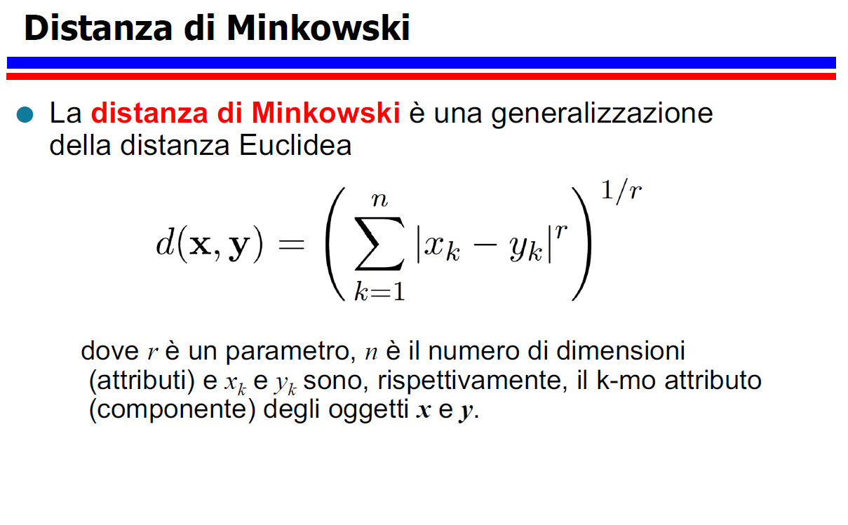

Slide 3
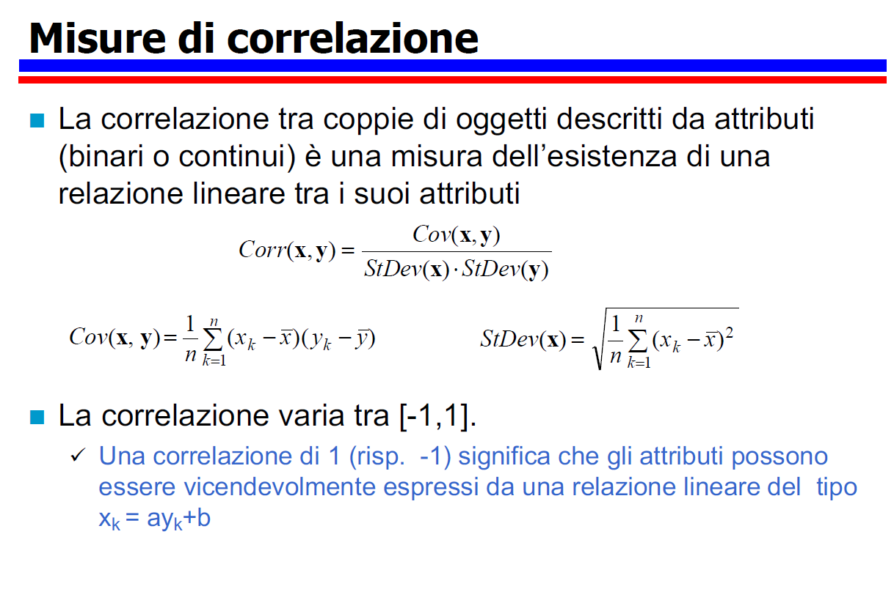

Slide 4
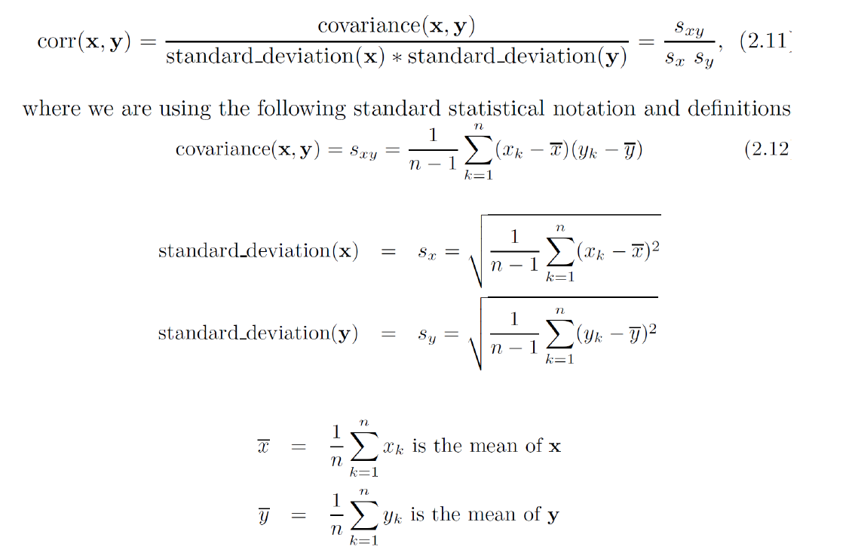

Slide 5
A real Machine Learning Project
In this lecture, you will go through an example project from start to end, as a real data scientist.
Here is an overview of all the steps you are going to deal with.
Frame the problem and look at the big picture
Get the data
Discover and visualize the data to gain insights
Prepare the data for Machine Learning Algorithms
Select a model and train it
Fine-tune your model.
Present your solution.
Launch, monitor, and maintain your system.

Slide 6
Look at the Big Picture and Frame the Problem
The dataset we are going to work with is a very famous dataset, i.e., the California Housing Prices dataset.
It contains information about houses, located in a certain California district. It is based on data collected from a 1990 California census.
Please note that the dataset needs to be cleaned. There are some pre-processing steps required in order to make it suitable to address a Data Mining Task.
Attributes
The attributes of the dataset are rather self explanatory.
longitude
latitude
housing_median_age
total_rooms
total_bedrooms
population
households
median_income
median_house_value
ocean_proximity

Slide 7
In the earliest stages of your project you need to understand what kind of problem you are approaching to.
In this context, you are required to build a model capable of approximating the price of houses in a california district.
More specifically, you wish to be able to predict the price associated with any given block.
A block is a general small geographical unit.
The model you are going to train will be able to predict the median housing price of any block belonging to the district this data refers to.
Once the overall goal is established, you can address the details of the problem at hand

Slide 8
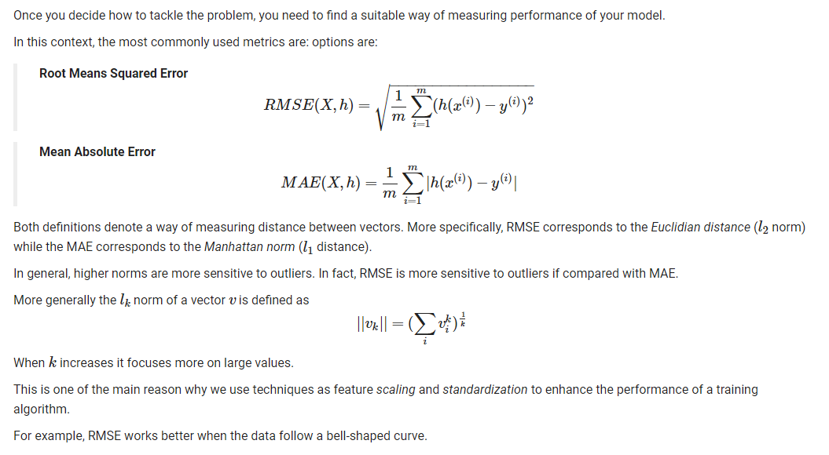

Slide 9
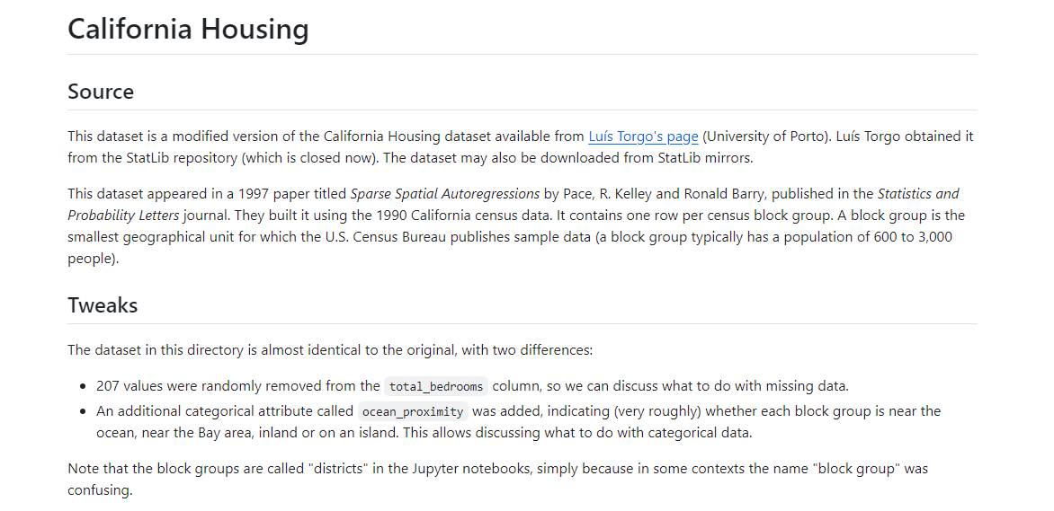
https://scikit-learn.org/stable/

Slide 10
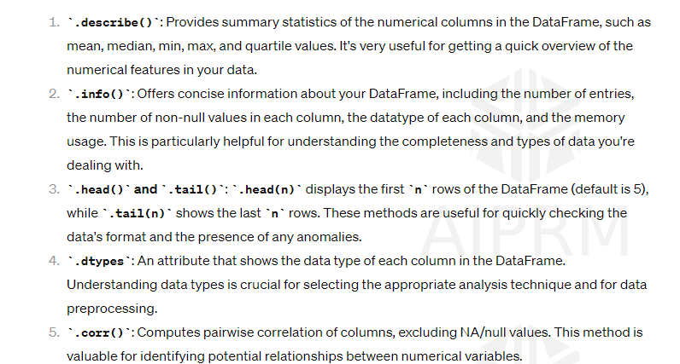

Slide 11
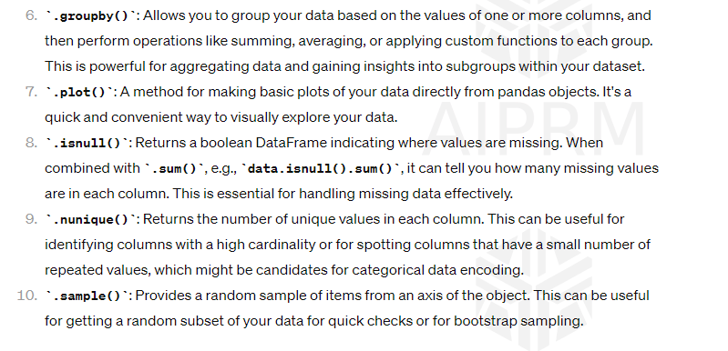

Slide 12
Splitting the data is a delicate and crucial task.
The main thing you want to avoid is to introduce: sampling bias. Also, you want the data contained in the test set to be a meaningful view on the original dataset.
Example When a survey company decides to call 1,000 people to ask them a few questions, they don’t just pick 1,000 people randomly in a phone booth.
They try to ensure that these 1,000 people are representative of the whole population.
For example, the US population is composed of 51.3% female and 48.7% male, so a well-conducted survey in the US would try to maintain this ratio in the sample: 513 female and 487 male.
This strategy is called stratified sampling (more here).
In order to do stratified sampling, the whole dataset is first divided into groups, i.e., strata.
The sampling procedure then must guarantee that each stratum has a sufficient number of sample. Where sufficient means that there are enough data to characterize the elements belonging to that specific category.
In the scenario depicted above, a poor sampling strategy has the 12% chance of providing a strongly unbalanced, thus not meaningful, test set.
Note: ``unbalanced does not imply not-meaningful
Clearly, if we introduce bias at this stage, we compromise all the training process.

Slide 13
What does it mean for a test set to be meaningful in our California housing problem?
A meaningful test set should guarantee a sufficient number of samples for every category of households income. (How rich people in a certain neighborhood are?)
In order to understand if the test set is well constructed, you may want to compare train set distribution with the one of the test set

Slide 14
